Slide 1
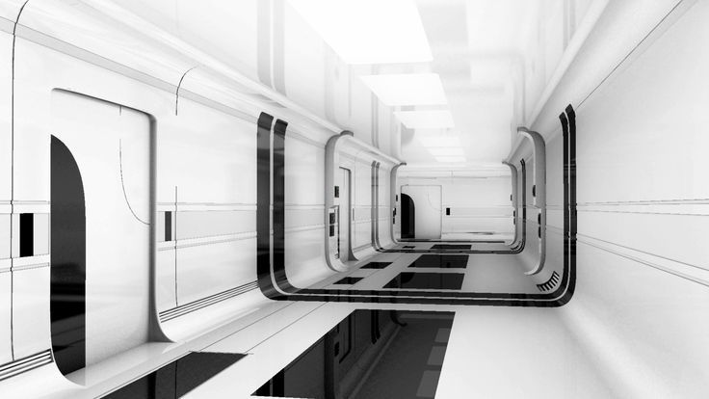
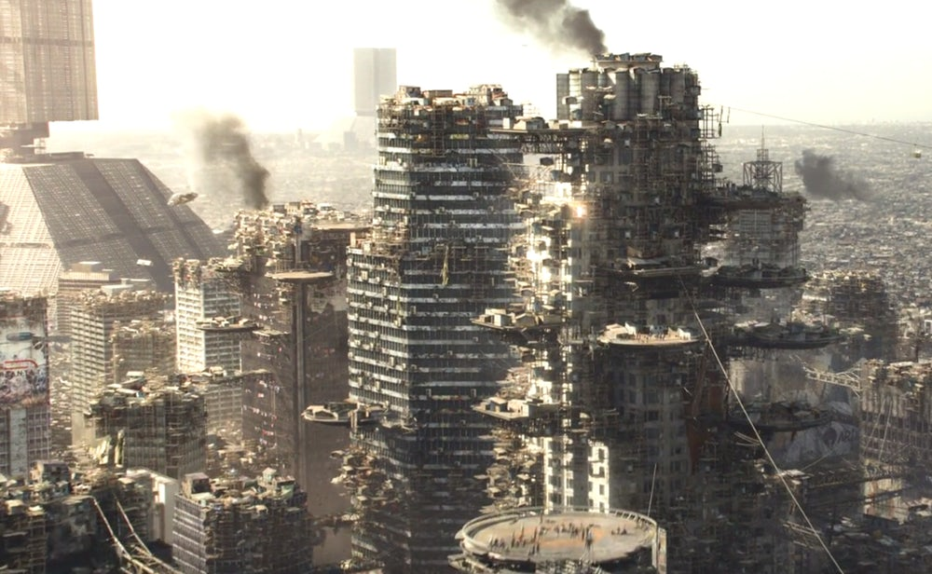
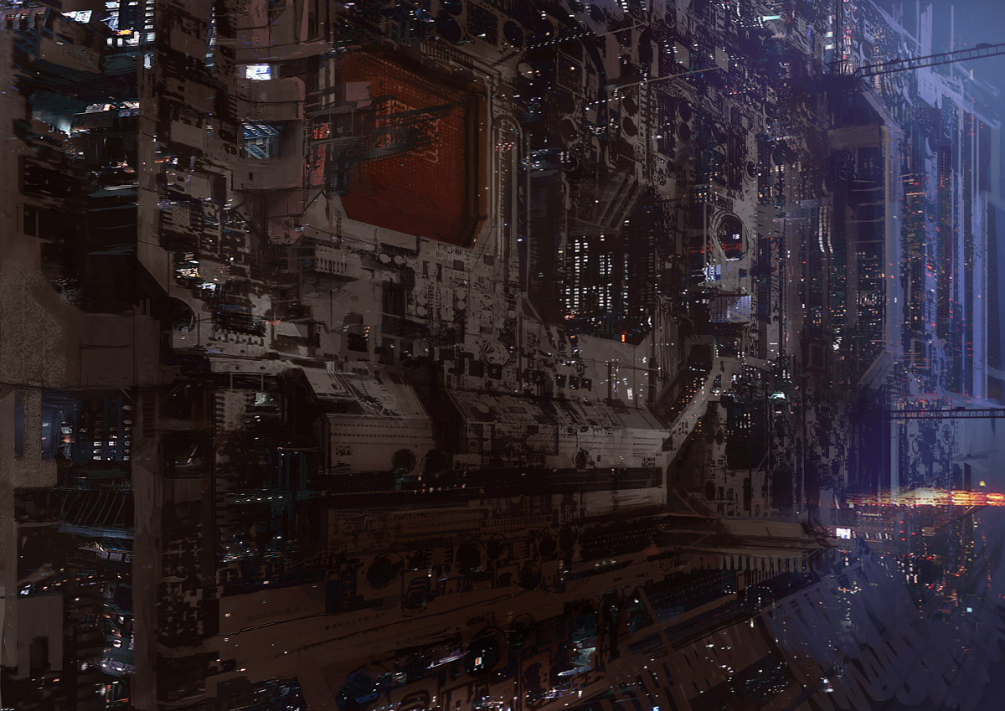
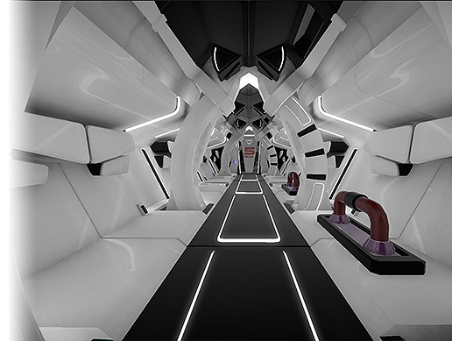
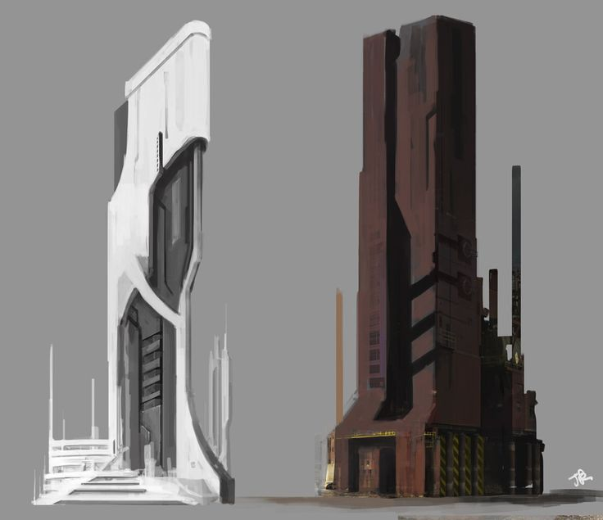
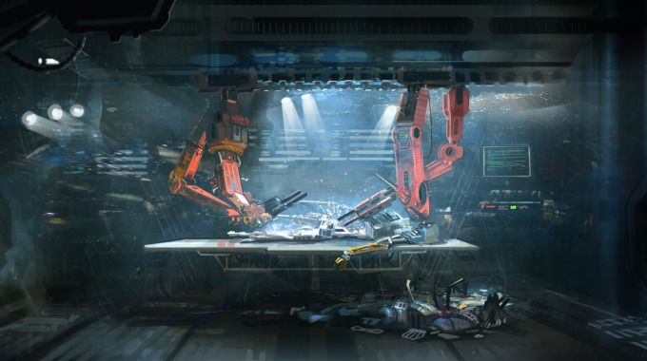

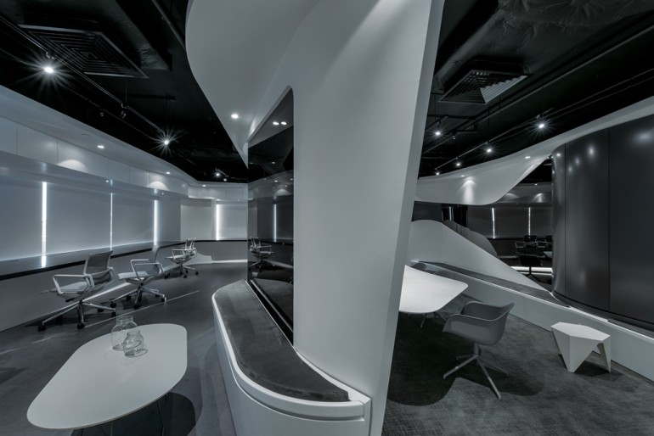
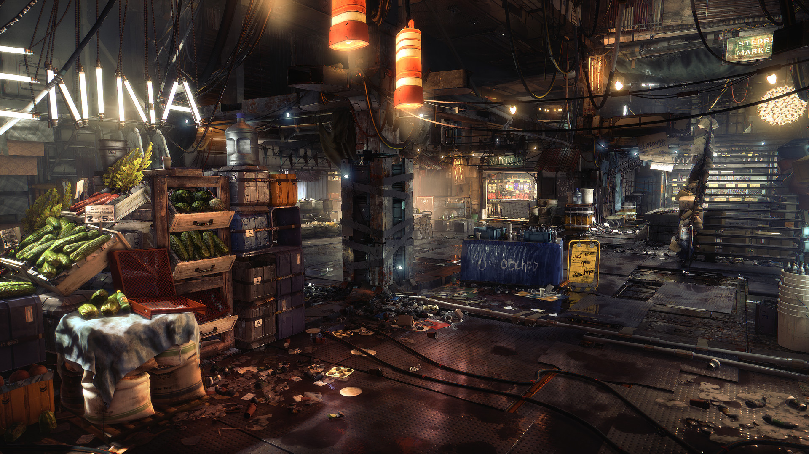
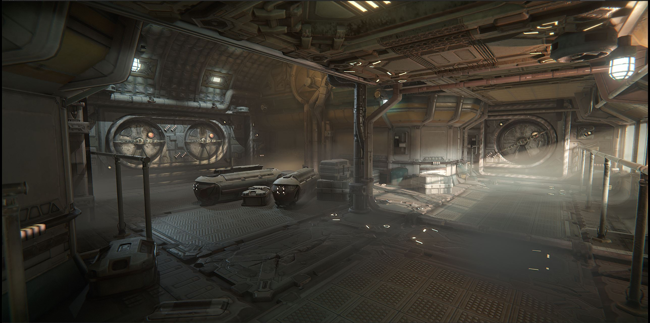
Setting Moodboard
The more rugged and down trodden version of a futuristic setting could also fit our game fairly well. A downside of using this would be that there is a lot of clutter, mess and dirt so it could potentially cause too much design work with the time we have with creating art assets. However, I feel this setting would fit the best with a more realistic and believable mix between modern and sci-fi military.
A more sleek setting for our game would make our theme much further into far future imagery. If we want to make our game seem more grounded with a mix of both modern and future technology this might not be the best style to go for. However, things like the curvature of corridors and sleek buildings could definitely be incorporated.

Slide 2
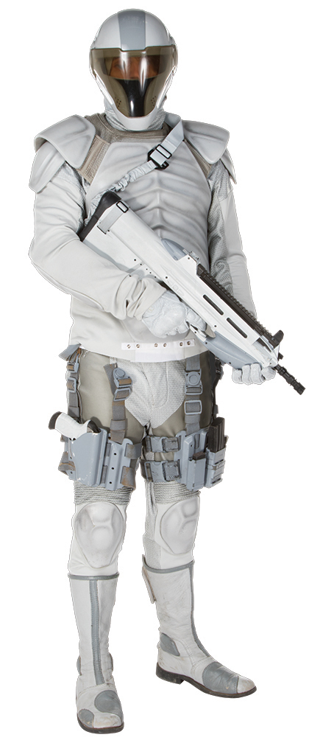
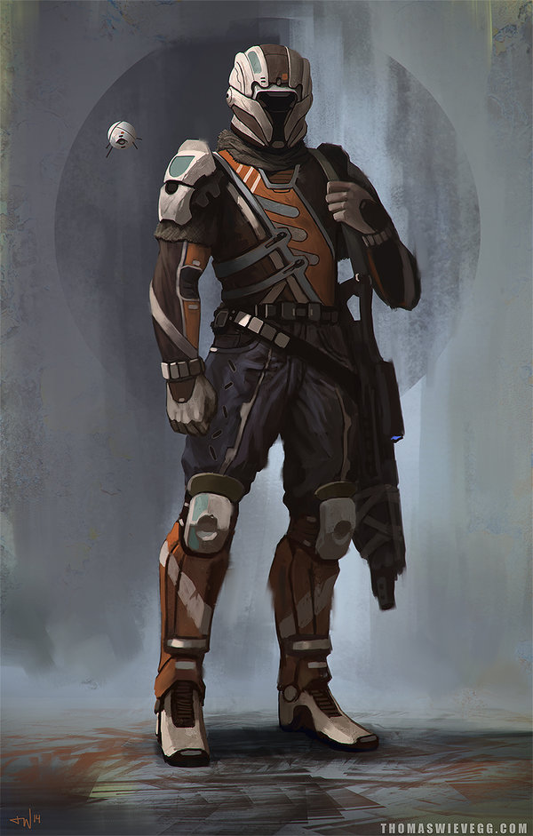
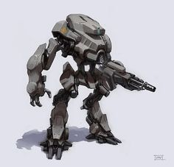
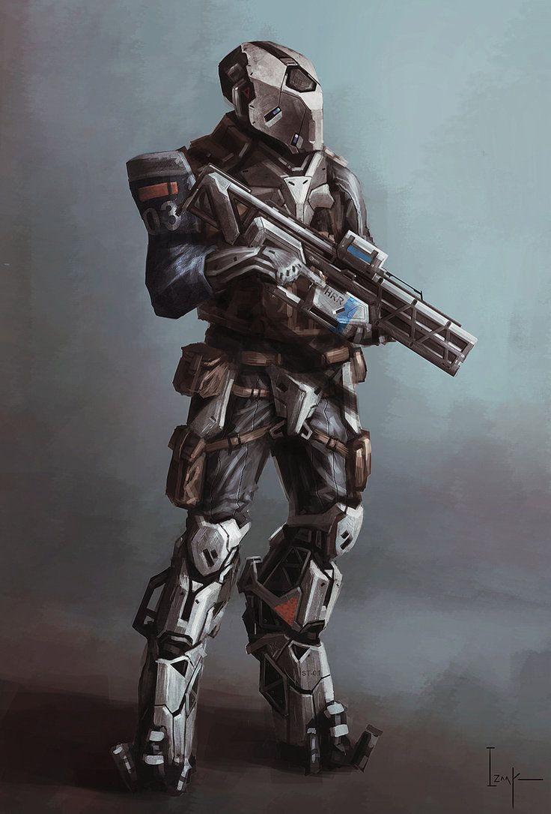
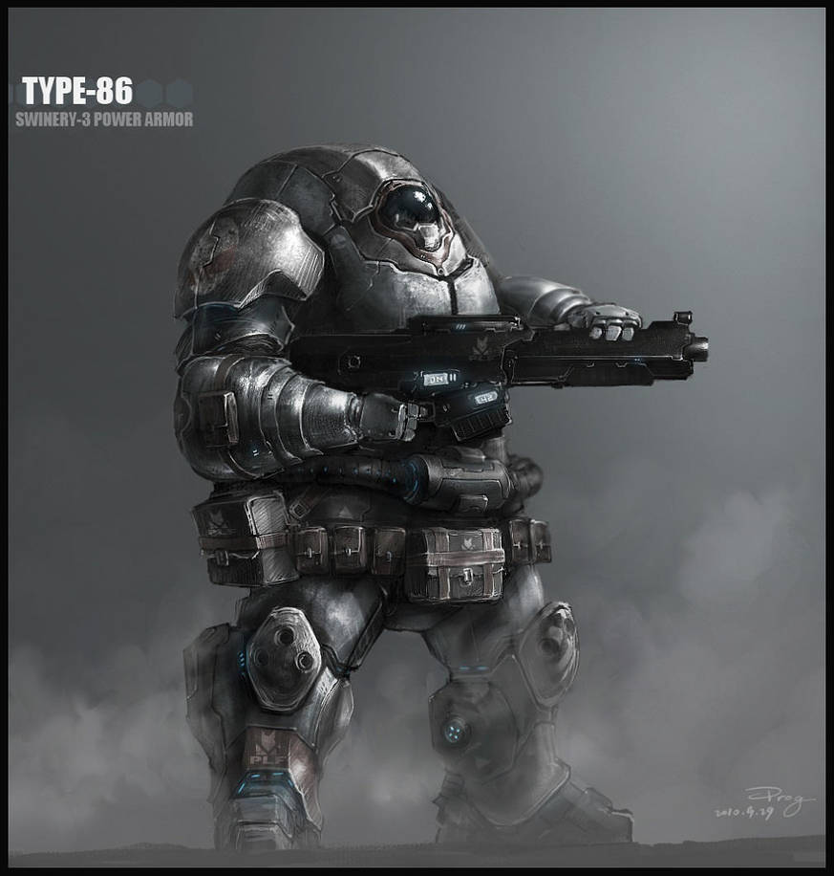
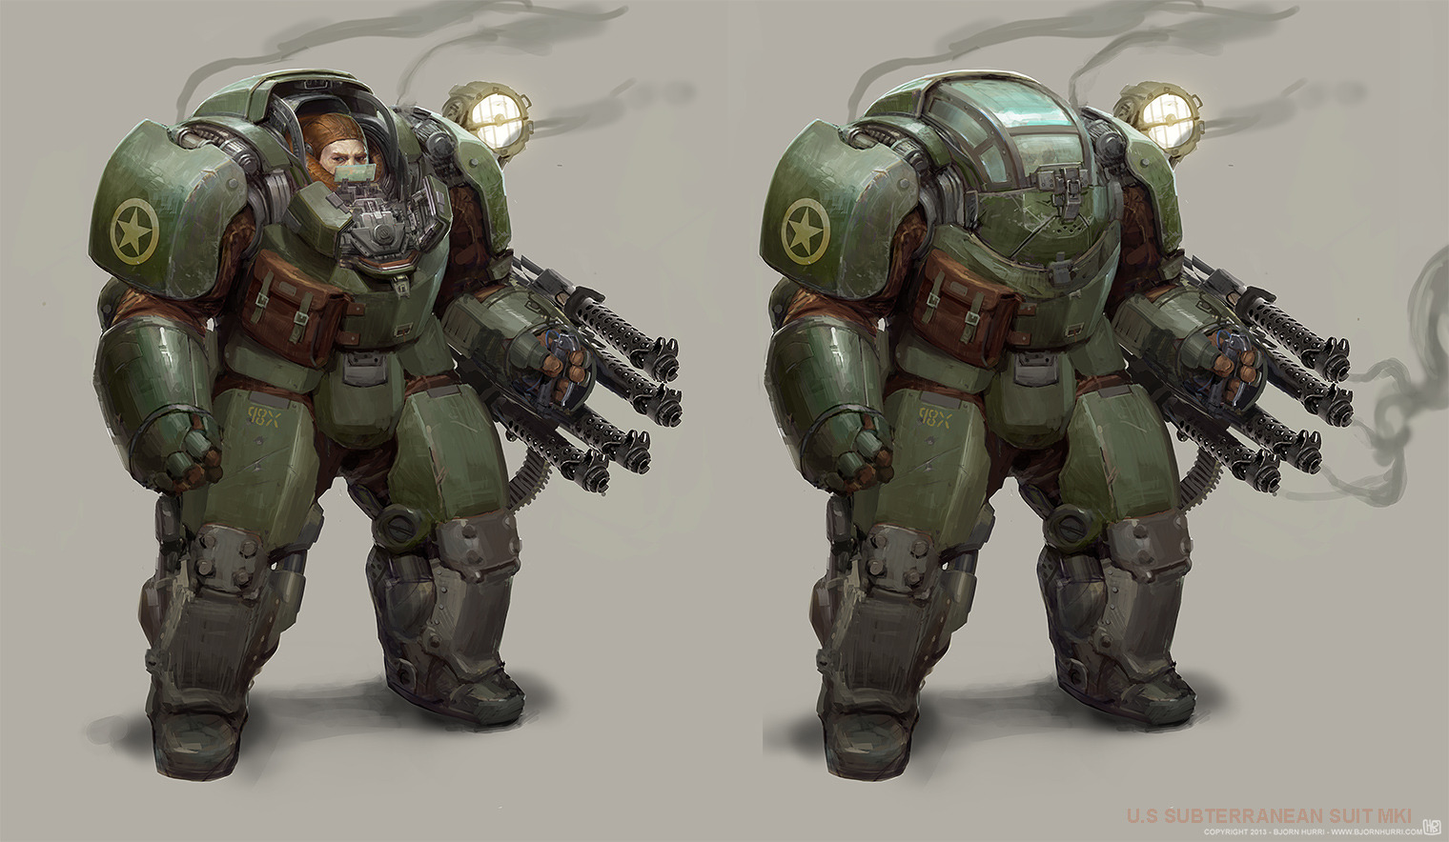
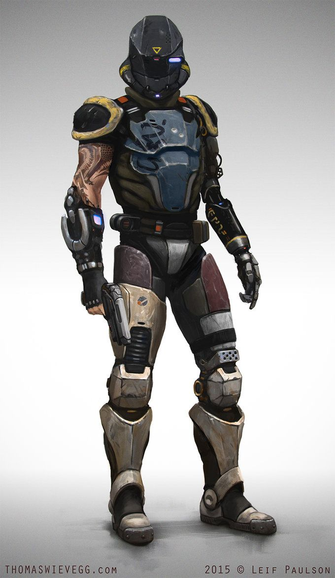
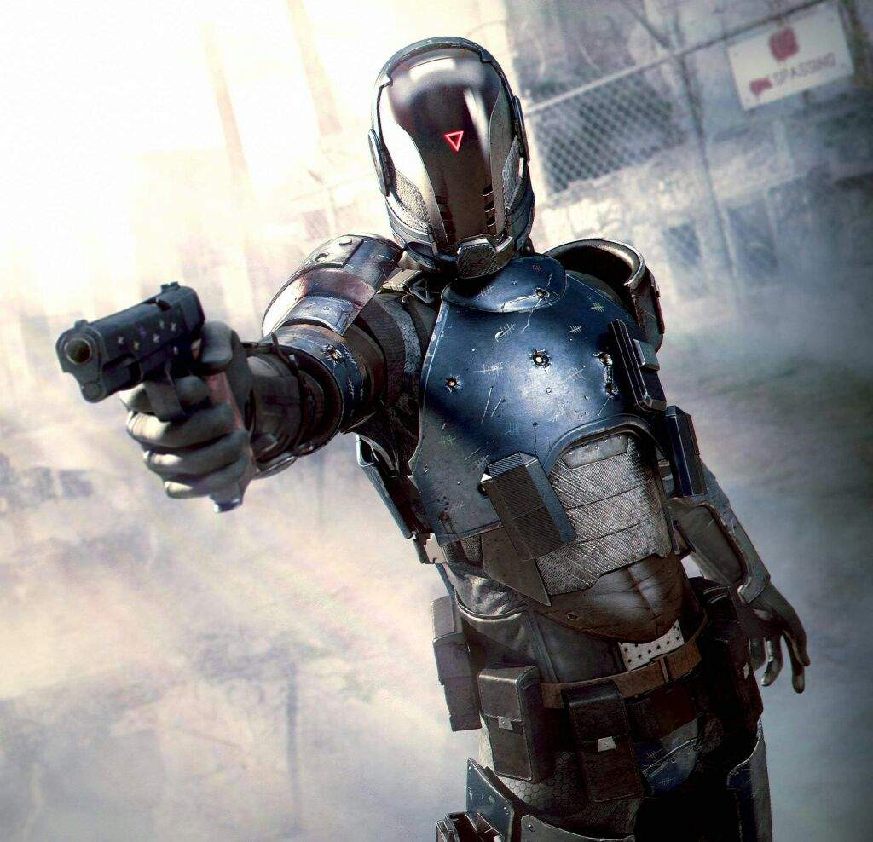
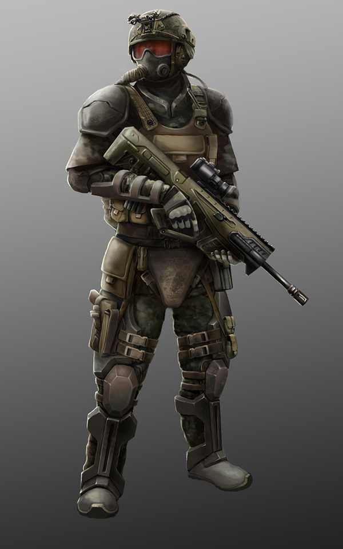
Character Moodboard
There are various versions of futuristic looking uniforms for soldiers. Ranging from smooth and sleek to more hard rigid edges. The type of armour used would heavily depend on the setting in general, though the more rigid dirtier armour would feel more grounded and still relatable to what we see now.
More traditional military uniforms with small amount of futuristic technology implemented into the design give a feeling of familiarity as well as letting us add small details to make the characters look more interesting.
Some enemies could have much bulkier armour than others to differentiate their appearance from other enemy types. This will make them more recognisable so that the player knows which enemy type they’re dealing with.

Slide 3
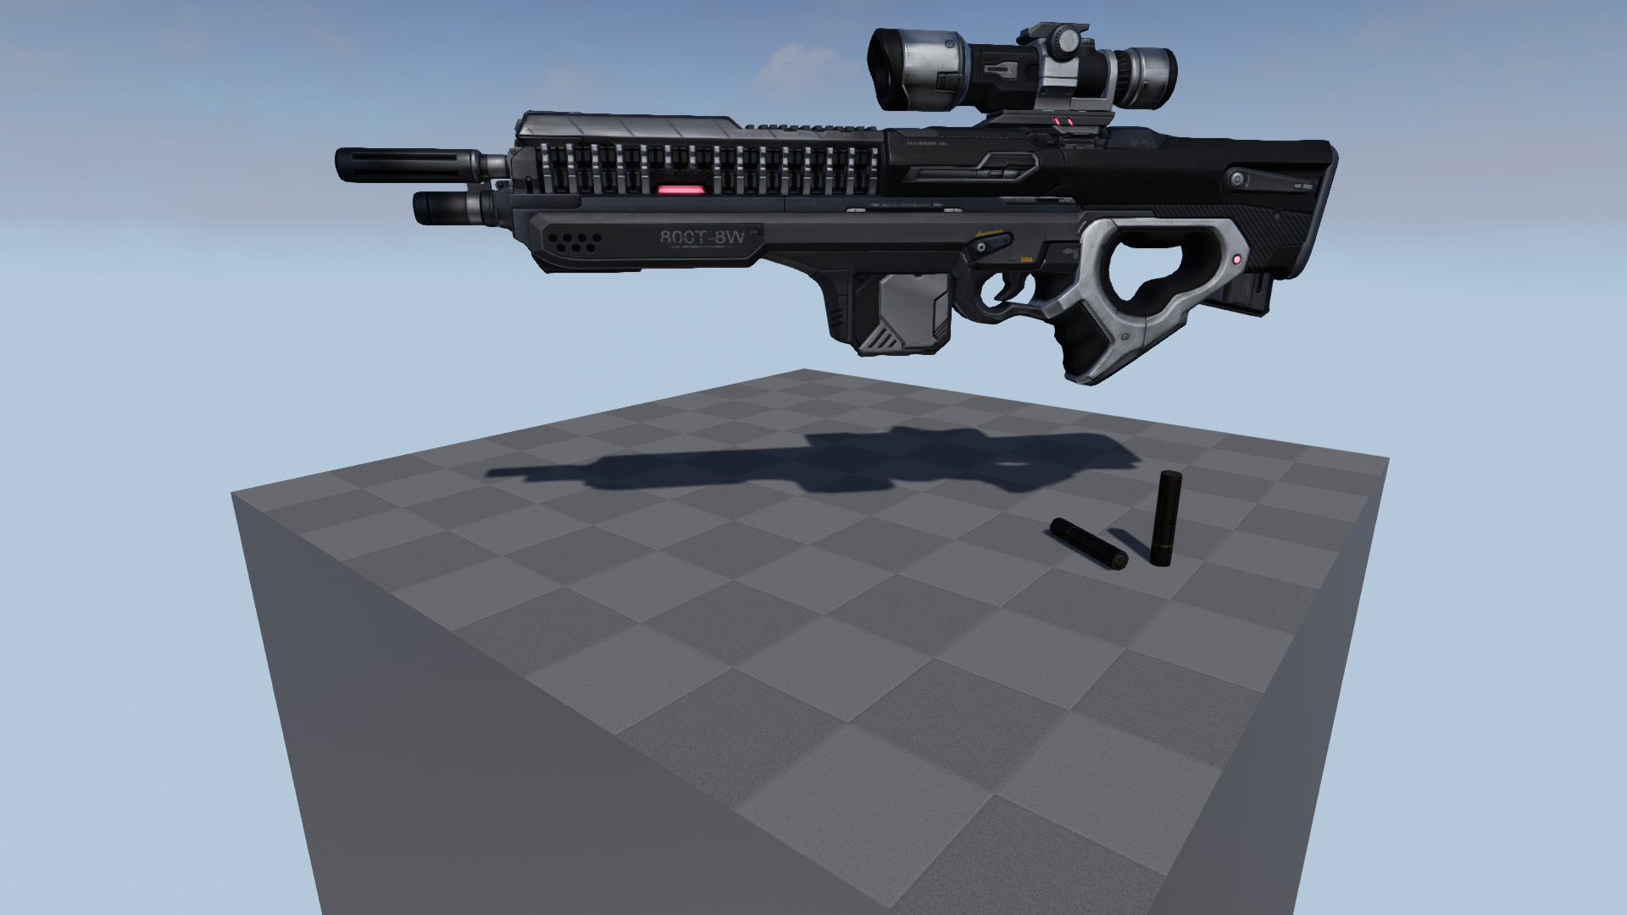
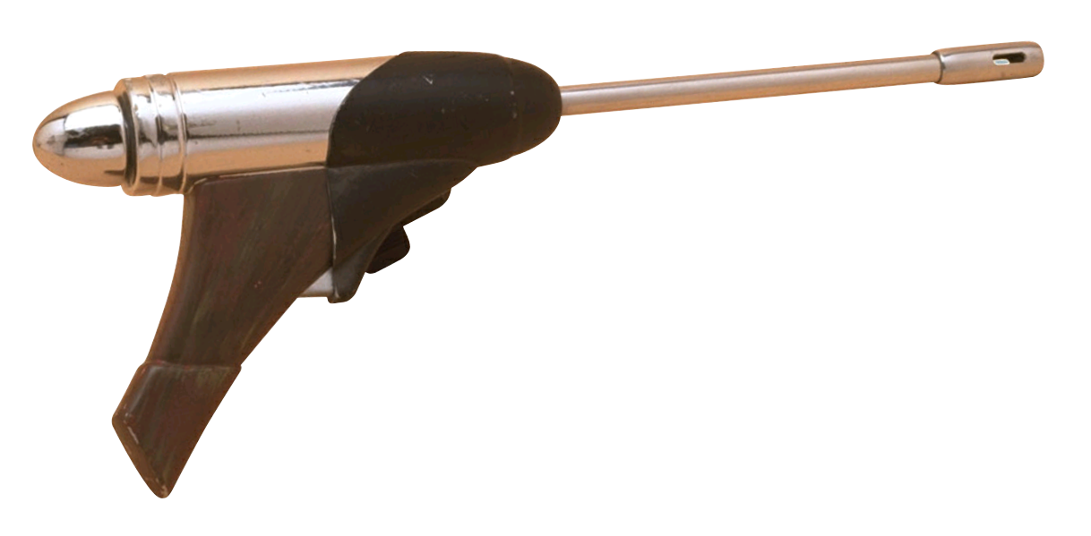
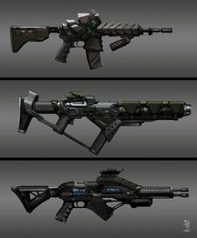
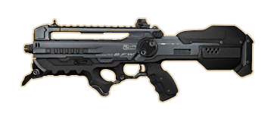
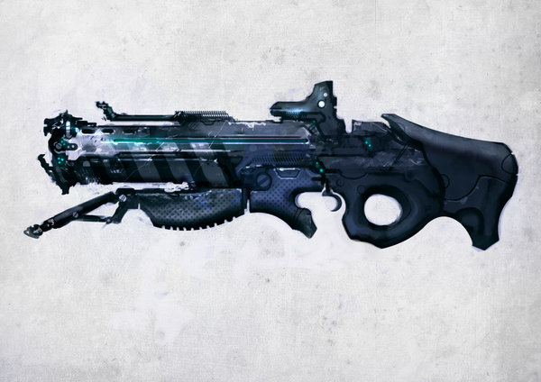
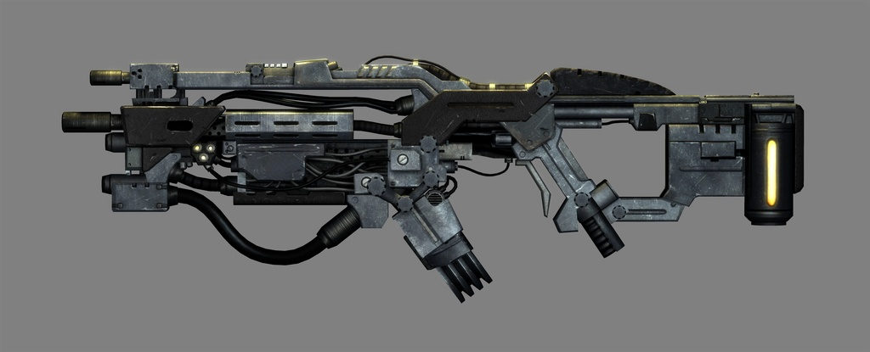
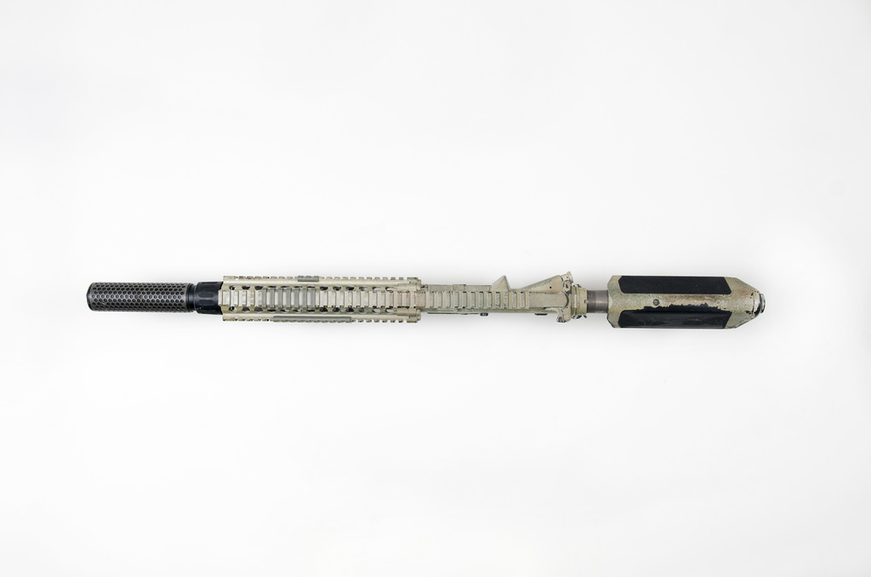
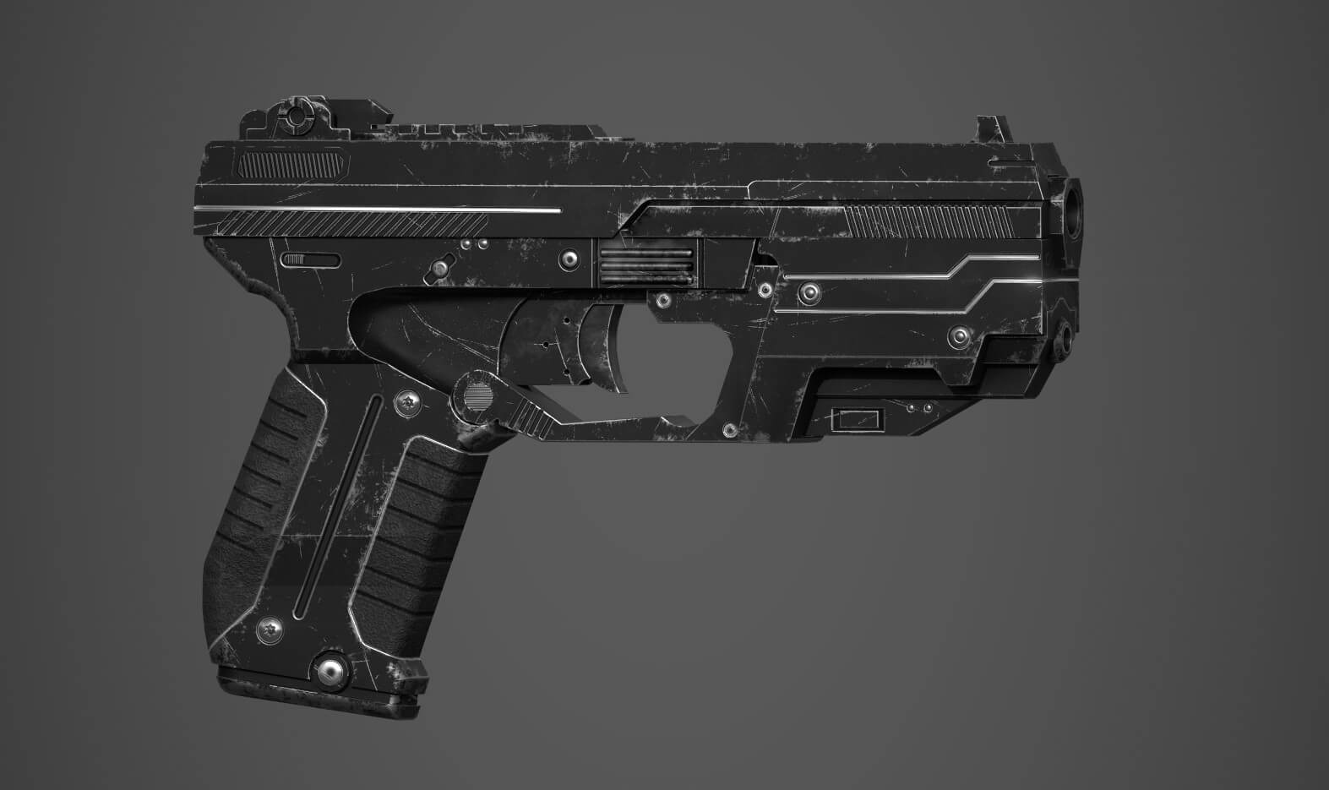
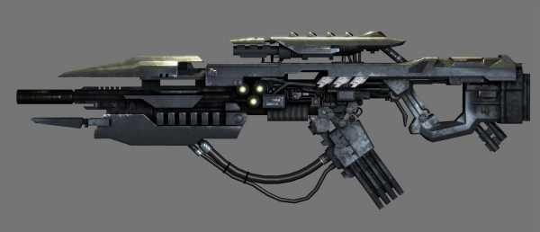
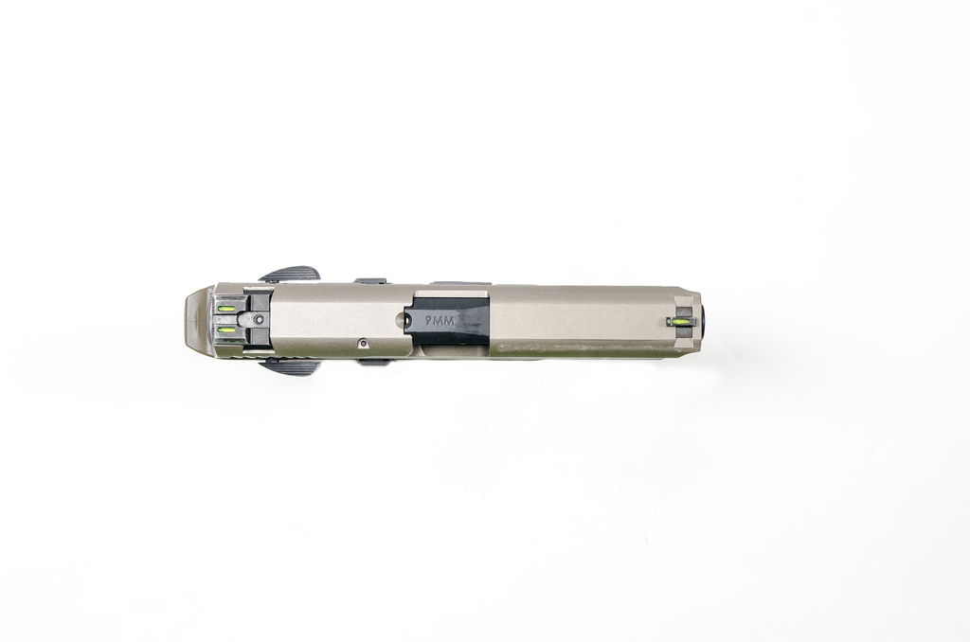
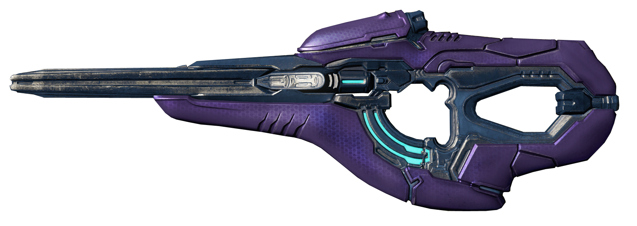
Weapons Moodboard
Another style of weapons we could go with is a much more futuristic and alien-like style. This could confuse the player more because they might not know what the enemy does at first glance, but I feel it would fit well if we intend on going for the more futuristic and sleek design.
A more modern looking style for our weapons with small futuristic elements implemented into their design could be the best approach. This would make it more likely that the players are more familiar with the weapons in the game and not completely alienate them with guns they have no idea of.

